Slide 1
Strategic Management
Understanding the competitive business strategies for growth
Week 4
Dr. Prerna Tambay
Mr. Andrew Bass
MB 5596

Slide 2



Prerna Tambay, PhD
HR Analytics Consultant and Lecturer
Dr. Prerna Tambay is an academic and a consultant.
She teaches in various universities in London, Oxford and Birmingham. She specializes in the are of Digital HR. She focuses on role of HR in Blockchain, AI and Analytics. He company provides consultancy services to SMEs to improve their organisational output through digital HR. She is passionate about improving organisational diversity and inclusion and she has developed various tools to improve the diversity withing organisations. As her employee wellbeing and organisational development agenda, she trains public sector employees (NHS) in Mindfulness and emotional intelligence.
She is now part of strategic management teaching team at Brunel and also does project management at Brunel Hive.
Andy Bass
Board Advisor – Business Transformation
Andy has 30 years leadership experience in the information technology sector holding board and C-level positions in multi-national corporations as well as small, medium and large private and public organizations. Throughout his career he has lived and worked in the UK, Europe, USA, Japan and the Middle East. Growth, transformation, and tactical execution have been key themes throughout his career, particularly in the sales and marketing arena, though he has also tackled the impact of large-scale facility closures, sales and marketing IT system roll-outs, and a major class-action lawsuit.
www.linkedin.com/in/bassandy

Slide 3
What did we learn last week?

Slide 4
Session 4: Learning Outcomes
Understanding the competitive business strategies for growth
01
02
03
04
WHY
WHAT
HOW
IMPACT
Strengths Weaknesses Opportunities Threats (SWOT)
two primary types of competitive advantage: cost advantage and differentiation advantage
Porter’s generic strategies; Bowman Strategy clock
Business level strategies and the creation of sustainable advantage

Slide 5

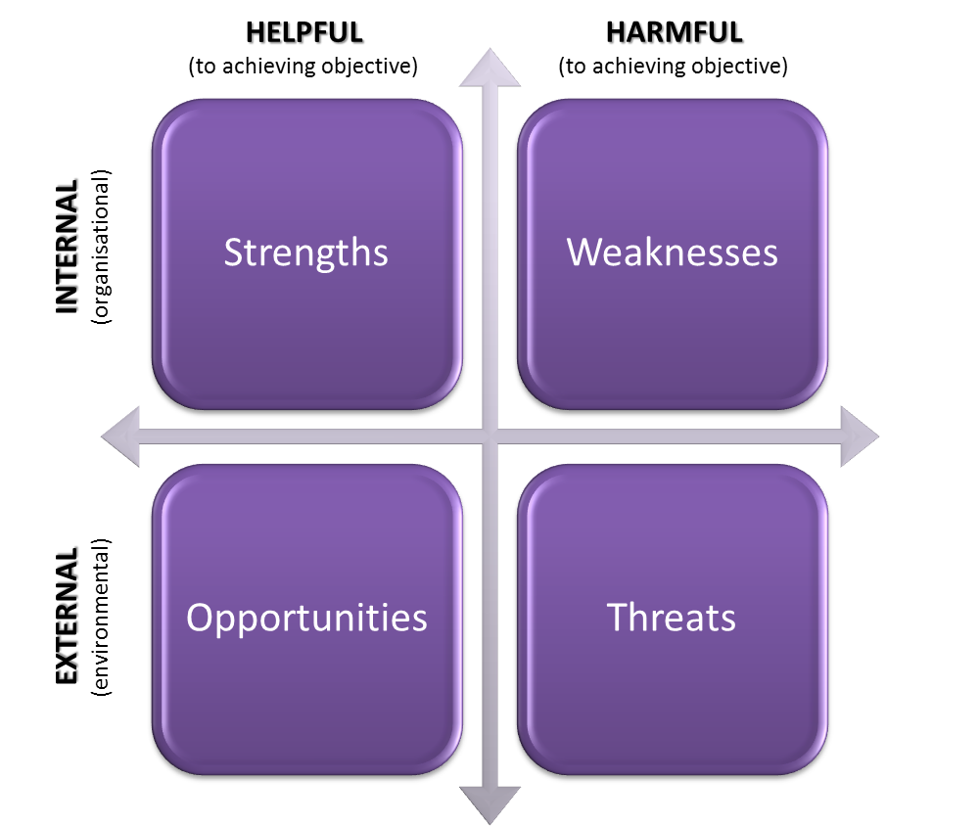
WHY? Identifies the Opportunities and Threats to an organisation.
Notes:
Why
Identifies the Opportunities and Threats to an organisation.
External scanning is part of the wider systematic strategy development that produces a business SWOT.

Slide 6

Sustaining a Competitive Advantage
CA subject to erosion by competition
Speed of erosion:
Dependent on imitation or innovation
Imitation is the most direct form of competition
To sustain CA, barriers to imitation must exist
Path dependence (R&D of old technology, Honda’s development of gas engine took decades and was leverage across multiple products)
Intellectual Properties (E.g Patents, Brand name, Big data, )
Social complexity (e.g social and business interacts, clubs, customer base)
Causal ambiguity (not clear cause and effect)
Notes:
(Make it difficult for competitors )

Slide 7
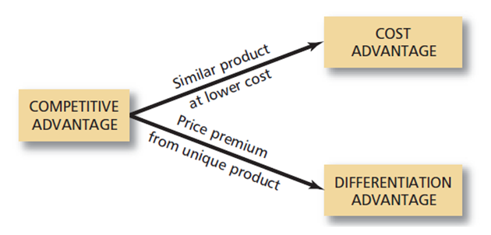
Sources of Competitive Advantage
A firm can achieve a higher rate of profit over a rival in one or two ways:
either it can supply an identical product or service at a lower price
or
it can supply a product or service that is differentiated in such a way that the customer is willing to pay a price premium that exceeds the additional cost of differentiation

Slide 8
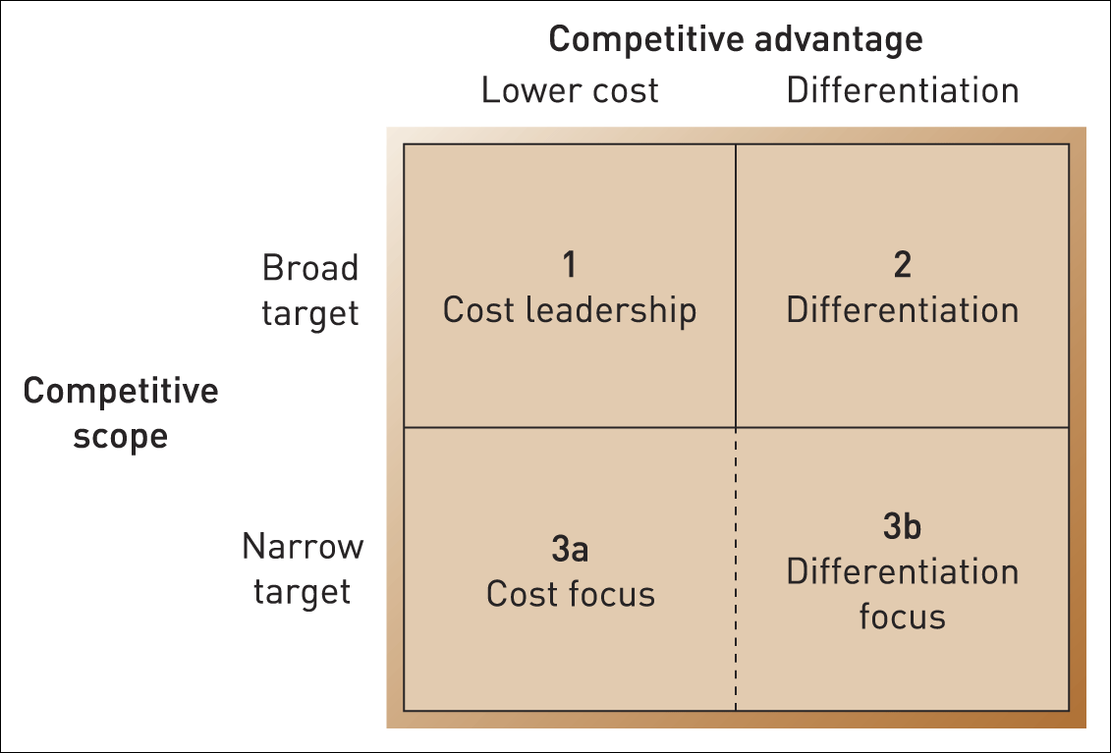
Porters Generic Strategies
Source: Adapted with the permission of The Free Press, a Division of Simon & Schuster, Inc., from Competitive Advantage: Creating and Sustaining Superior Performance by Michael E. Porter. Copyright © 1985, 1998 by Michael E. Porter. All rights reserved.
Notes:
Michael Porter introduced the term ‘generic strategy’ to mean basic types of competitive strategy that hold across many kinds of business situations.
Source of Competitive Advantage
Broad target or Industry wide
Narrow Target or single segment

Slide 9

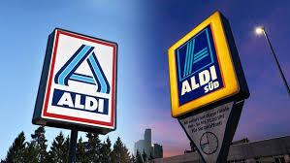

Cost-leadership
01
Cost-leadership strategy involves becoming the lowest-cost organisation in an industry (e.g., Primark in clothing, Aldi in grocery retailing, Hyundai in automobile industry).
Four key cost drivers that can help deliver cost leadership:
Lower input costs (e.g., labour or raw materials, locational differences, relationships with the suppliers)
Economies of scale (spreading fixed costs over high levels of output)
Experience (i.e., gains in labour productivity and increasing efficiency in design or equipment)
Product/process new design (e.g., production, distribution, and customer-service)
Notes:
The development or adoption of a new production technique can be an important source of competitive advantage
Relationships with the supplier: Supplier relationships
Especially beneficial: where customers are price sensitive

Slide 10
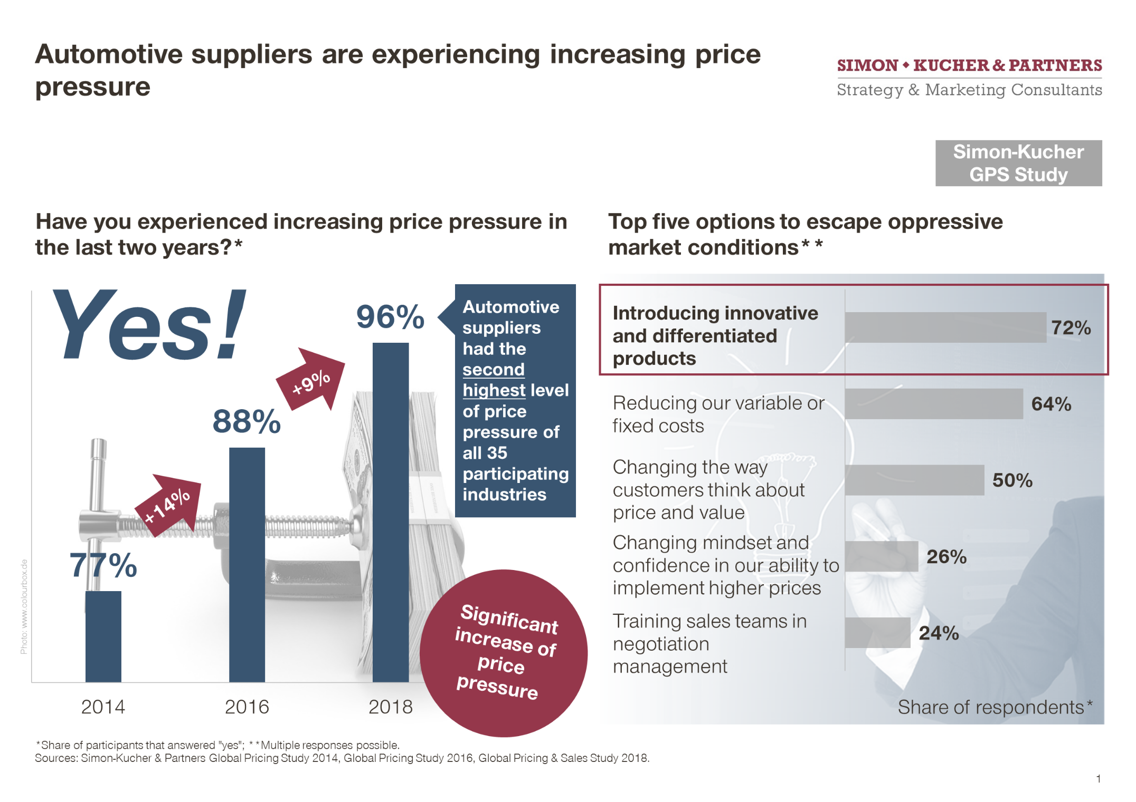

Slide 11

Cost-leadership: risks involved…
Other firms may be able to lower their costs as well
It could lead to a damaging price wars
There might be a difficulty in sustaining cost leadership in the long run
A firm following a focus strategy might be able to achieve even lower cost within their segment

Slide 12
Differentiation strategies
02
Definition: Providing something unique that is valuable to the buyer beyond simply offering a low price (M. Porter)
THE KEY IS CREATING VALUE FOR THE CUSTOMER
TANGIBLE DIFFERENTATION:
Observable product characteristics: • size, color, materials, etc.
• performance
• packaging
• complementary services
INTANGIBLE DIFFERENTATION:
Unobservable and subjective characteristics relating to image, status, identity
TOTAL CUSTOMER RESPONSIVENESS
Differentiation not just about the product, it embraces the whole relationship between the supplier and the customer.
Notes:
Two key issues:
The strategic customer on whose needs/characteristics the differentiation is based
Key competitors – who are the rivals and who may become a rival.
Note → Just as cost-leaders should not neglect quality, so should differentiators attend closely to costs (especially in areas irrelevant to their sources of differentiation)

Slide 13
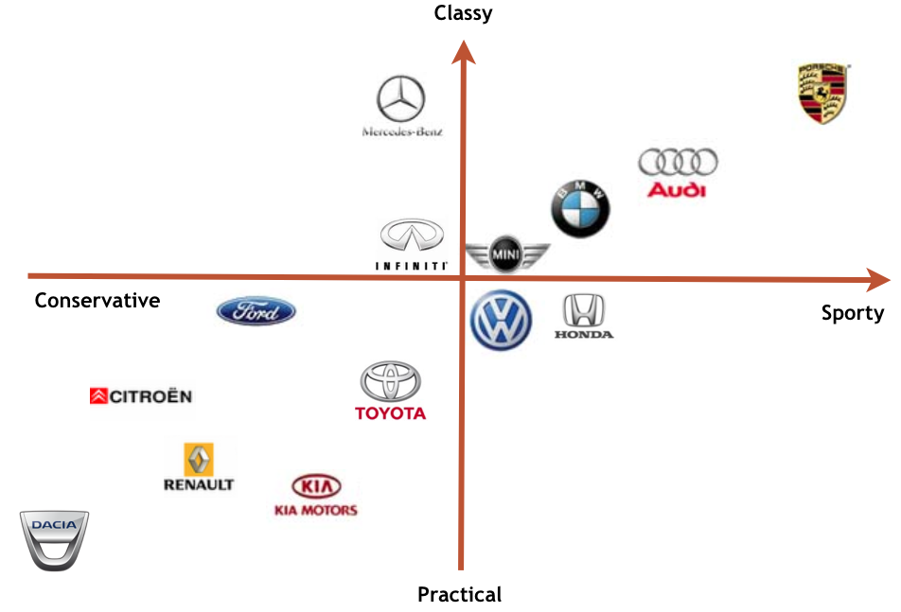
Differentiation in the automobile industry

Slide 14
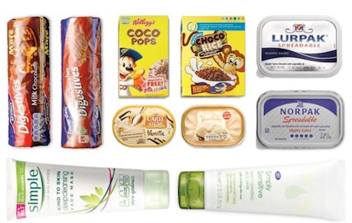
Differentiation strategies: risks involved…
Involves higher costs
Customers might become price sensitive and choose on price rather than uniqueness
Customers may no longer need the differentiation factor
Imitation by competitors and changes in customer tastes
Rivals pursuing a focus strategy may be able to achieve even greater differentiation in their market segments

Slide 15
Focus strategies
A focus strategy targets a narrow segment and tailors its products or services to the needs of that specific segment to the exclusion of others.
Two types of focus strategy:
Cost-focus strategy: The product will be basic - perhaps a similar product to the higher-priced and featured market leader, but acceptable to sufficient consumers. Such products are often called "me-too's".
Differentiation focus strategy : The special customer needs of the segment mean that there are opportunities to provide products that are clearly different from competitors who may be targeting a broader group of customers
Notes:
A firm that follows cost focus strategy does not necessarily charge the lowest prices in the industry. Instead, it charges low prices relative to other firms that compete within the target market

Slide 16
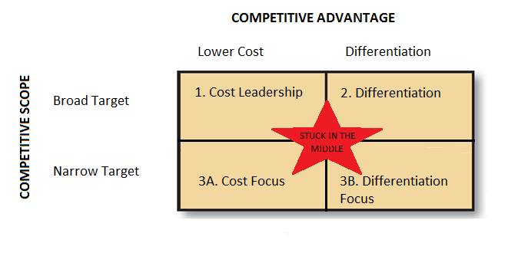
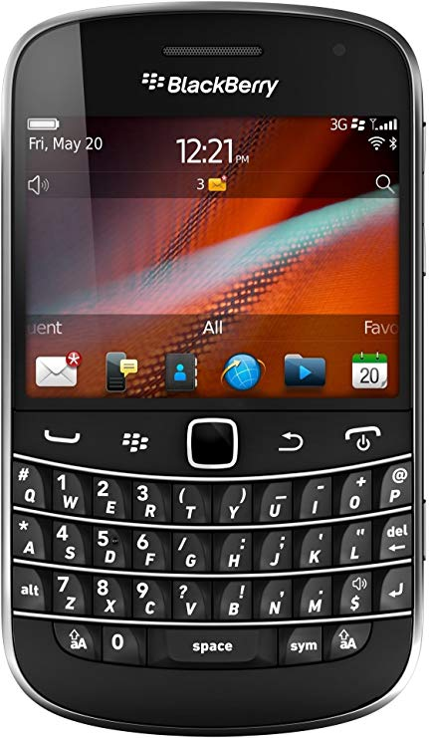
‘Stuck in the middle’?
Porter argues:
It is best to choose which generic strategy to adopt and then stick rigorously to it.
Failure to do this leads to a danger of being ‘stuck in the middle’ – doing no strategy well
The argument for pure generic strategies is controversial.
Porter acknowledges that the strategies can be combined----- But how?

Slide 17
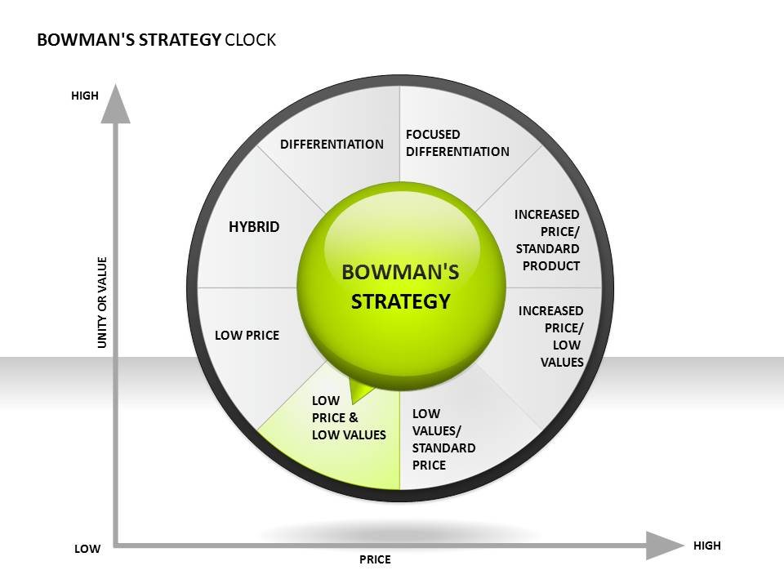

Slide 18
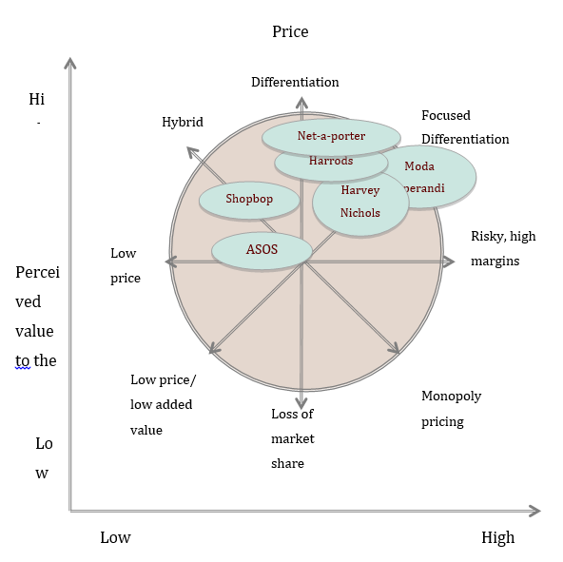
Strategic group analysis: Price vs Market Share

Slide 19
Bowman's Strategy Clock
Bowman's Strategy Clock is a very useful model to help you understand how companies compete in the marketplace.
By looking at the different combinations of price and perceived value, you can begin to choose a position of competitive advantage that makes sense for you and your organization's competencies.
This is a powerful way of looking at how to establish and sustain a competitive position in a market driven economy.
By understanding these eight basic strategic positions, you can analyze and evaluate your current strategy and determine if adjustments might improve your overall competitive position

Slide 20

Coopetition?: Competition and collaboration
https://kongres-magazine.eu/2015/10/the-autumn-issue-is-here/coopetition-3/

Slide 21


Slide 22

EXTRA SLIDES – NOT INCLUDED IN THE CLASS PRESENTATION

Slide 23
BOWMAN’S STRATEGY CLOCK
Position 1: Low Price - Low Value
A low price – low value positioning -- is offering poor quality products at the lowest price in the market.
Many companies adopt such a strategy when their products come under pressure from the competitors low prices, and they cannot overcome such price wars by offering products that differ in some way.
Companies adopting this strategy would require high sales volumes to compensate for the low prices, and by extension low margins.
The low price would fetch such volumes, but the low quality would mean that most customers would try the product only once.
As such, this strategy suits only products with a short life cycle, where repeat customers are not relevant, or on products where quality is not an issue

Slide 24
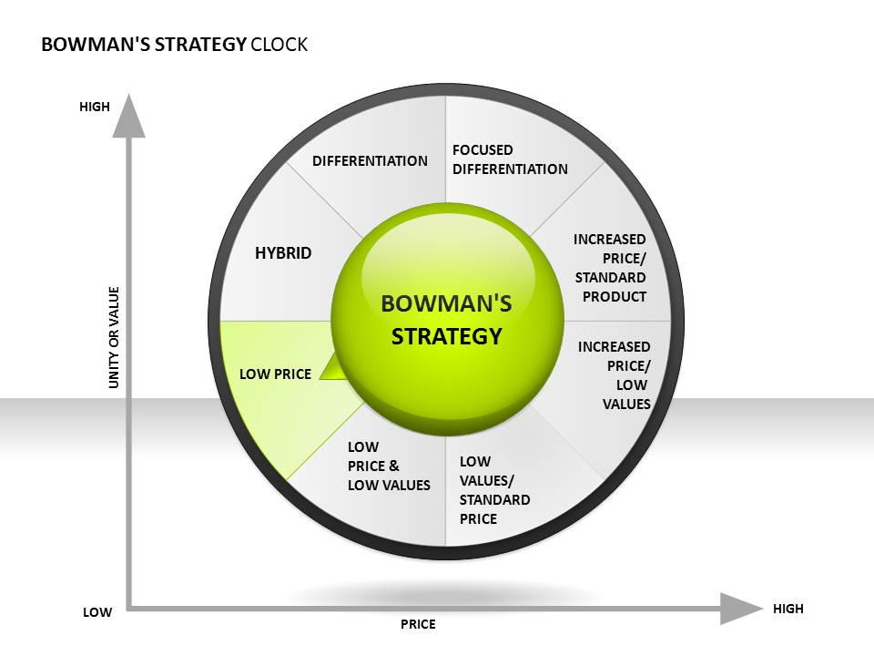
BOWMAN’S STRATEGY CLOCK
Position 2: Low Price
Companies competing in this category are the low cost leaders.
These are the companies that drive prices down to bare minimums, and they balance very low margins with very high volume.
If low cost leaders have large enough volume or strong strategic reasons for their position, they can sustain this approach and become a powerful force in the market.
If they don't, they can trigger price wars that only benefit consumers, as the prices are unsustainable over anything but the shortest of terms.
Walmart is a key example of a low price competitor that persuades suppliers to enter the low price arena with the promise of extremely high volumes

Slide 25
First two options are about the low price. First option is totally low cost low added value but the second option totally about to be a “cost leader” without caring its value. Second option has the risk of price war and low margin.

Slide 26
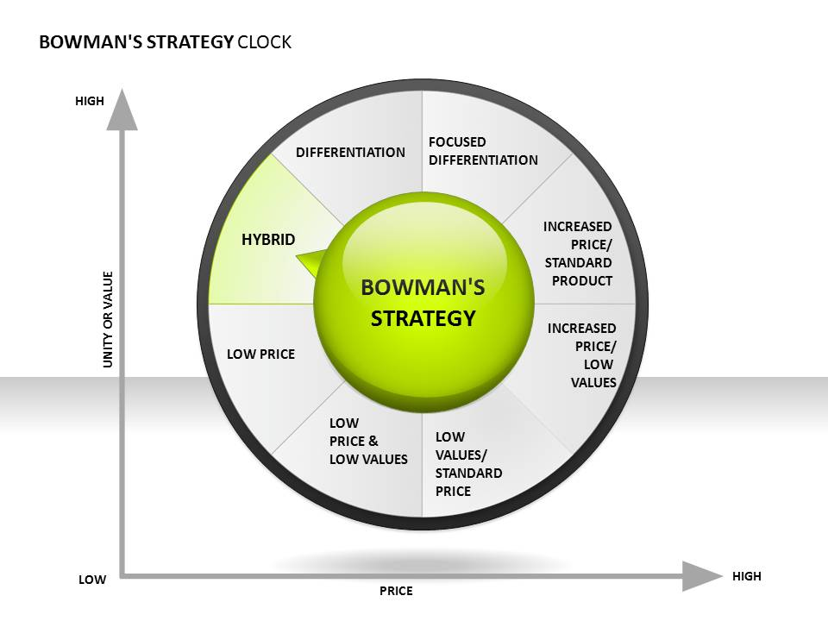
Position 3: Hybrid (moderate price/moderate differentiation)
Hybrids are interesting companies.
They offer products at a low cost, but offer products with a higher perceived value than those of other low cost competitors.
Volume is an issue here but these companies build a reputation of offering fair prices for reasonable goods.
BOWMAN’S STRATEGY CLOCK
Good examples of companies that pursue this strategy are discount department stores.
The quality and value is good and the consumer is assured of reasonable prices.
This combination builds customer loyalty.

Slide 27
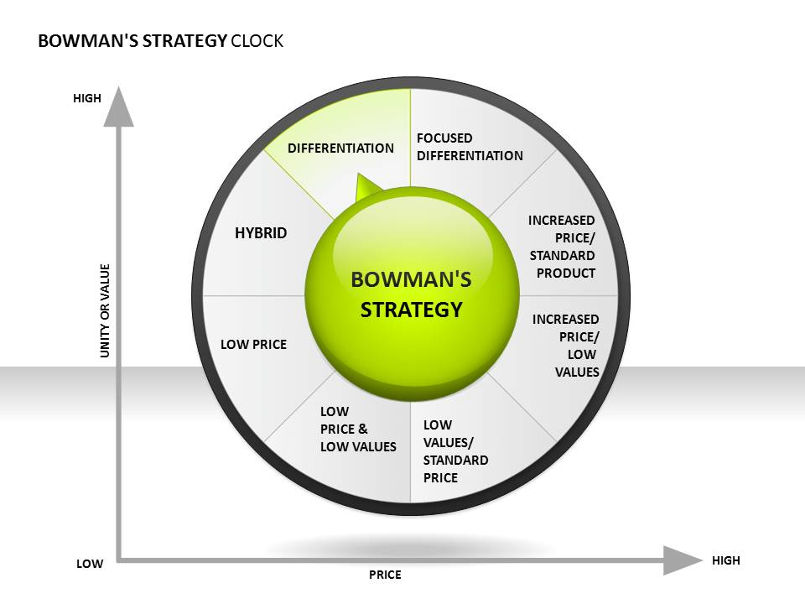
BOWMAN’S STRATEGY CLOCK
Position 4: Differentiation
Companies that differentiate offer their customers high perceived-value.
To be able to afford to do this they either increase their price and sustain themselves through higher margins, or they keep their prices low and seek greater market share.
Branding is important with differentiation strategies as it allows a company to become synonymous with quality as well as a price point.
Nike is known for high quality and premium prices; Reebok is also a strong brand but it provides high value with a lower premium.

Slide 28
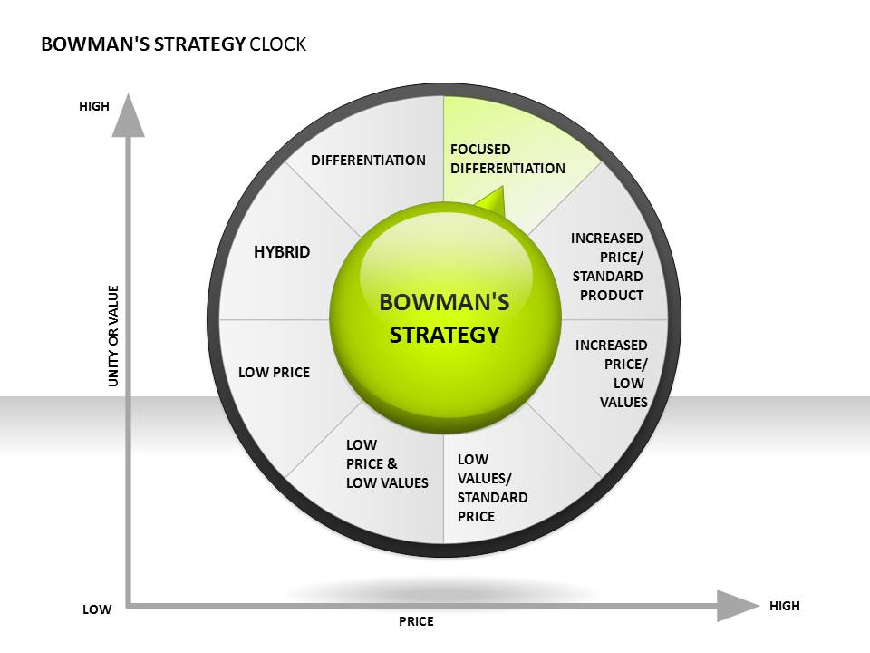
BOWMAN’S STRATEGY CLOCK
Position 5: Focused Differentiation
These are your designer products: High perceived value and high prices.
Consumers will buy in this category based on perceived value alone.
The product does not necessarily have to have any more real value, but the perception of value is enough to charge very large premiums.
Think Gucci, Armani, Rolls Royce. clothes either cover you or they don't, and a car either gets you around the block or it doesn't.
If you believe pulling up in your Rolls Royce Silver Shadow is worth 25 times more than in an economy Ford then you will pay the premium.
Highly targeted markets and high margins are the ways these companies survive

Slide 29
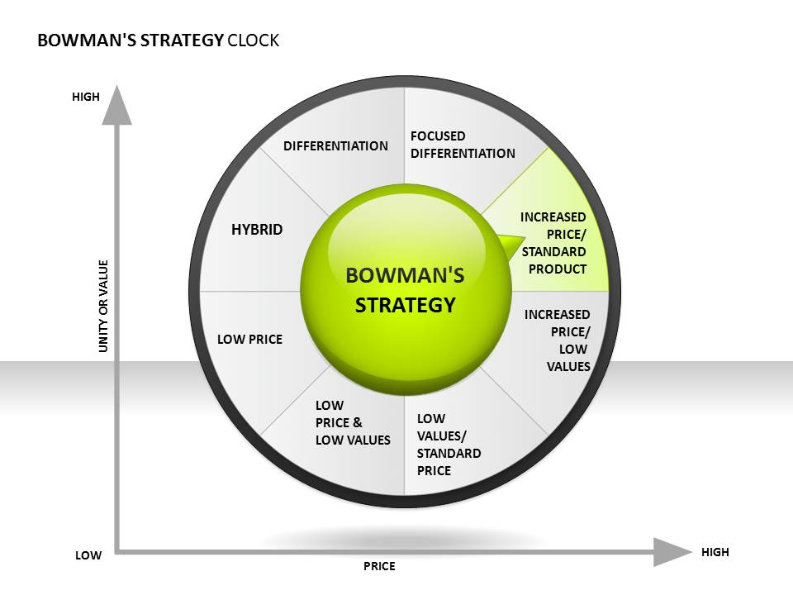
BOWMAN’S STRATEGY CLOCK
Position 6: Increased Price/Standard Product
Sometimes companies take a gamble and simply increase their prices without any increase to the value side of the equation.
When the price increase is accepted, they enjoy higher profitability.
When it isn't, their share of the market plummets, until they make an adjustment to their price or value.
This strategy may work in the short term, but it is not a long-term proposition as an unjustified price premium will soon be discovered in a competitive market.

Slide 30
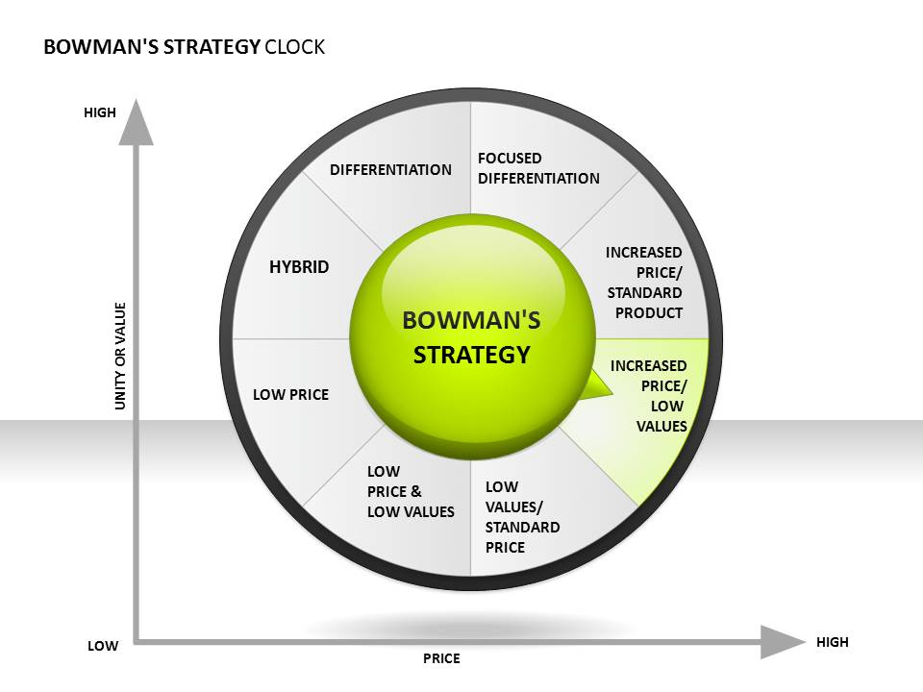
BOWMAN’S STRATEGY CLOCK
Position 7: High Price/Low Value
This is classic monopoly pricing, in a market where only one company offers the goods or service.
As a monopolist, you don't have to be concerned about adding value because, if customers need what you offer, they will pay the price you set, period.
Fortunately for consumers in a market economy, monopolies do not last very long, if they ever get started, and companies are forced to compete on a more level playing field

Slide 31
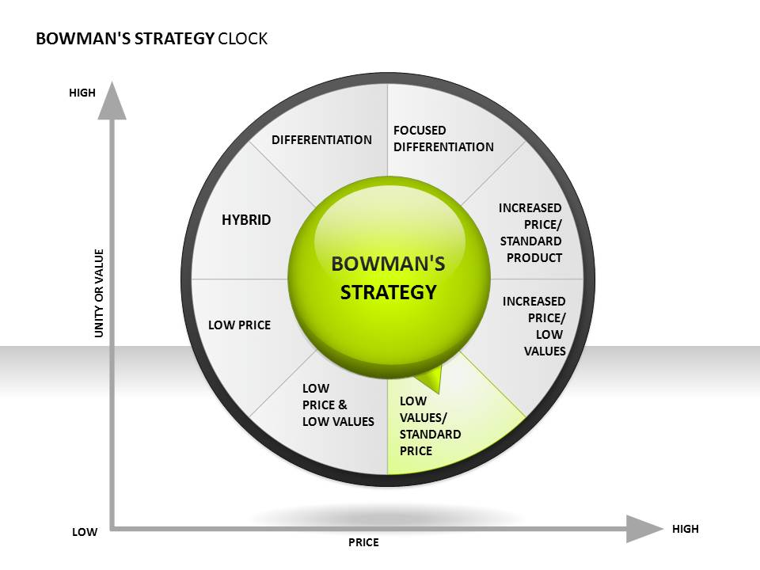
BOWMAN’S STRATEGY CLOCK
Position 8: Low Value/Standard Price
Any company that pursues this type of strategy will lose market share.
If you have a low value product, the only way you will sell it is on price.
You can't sell day-old bread at fresh prices
Mark it down a few cents, and suddenly you have a viable product. That is the nature of consumer behavior, and you will not get around it, no matter how hard you try.

Slide 32
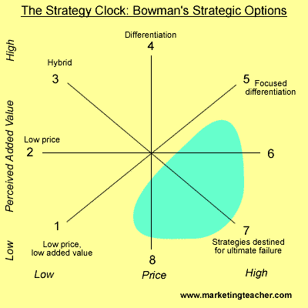
Positions 6, 7, and 8 are not viable competitive strategies in truly competitive marketplaces.
Whenever price is greater than perceived value you have an uphill battle on your hands.
There will always be competitors offering better quality products at lower prices so you have to have your value and price aligned correctly.

Slide 33
When considering which competitive strategy to pursue, here are some questions you should ask yourself.
If you intend to compete on price:
Are you a price leader?
Can you sustain a cost leader position? Can you control your costs and sustain a good margin?
Are you able to exploit all of the cost advantages available to you?
Can you balance low price against the perception of too low value?
Is your cost advantage limited to one or a few small market segments? Are these segments capable of sustaining your business, given the volume and margins you project?
If you intend to compete on perceived value:
Do you have a well-identified target market?
Do you understand what your target market truly values?
Are you aware of the perceived value of your competitor's products?
Are there areas of differentiation that you can capitalize on that others cannot easily copy?
Do you have alternate methods of differentiation in the event you lose your competitive advantage in that area?

Slide 34
Summary
Business strategy is concerned with seeking competitive advantage in markets at the business rather than corporate level.
Porter’s framework and the Strategy Clock define various generic strategies, including cost-leadership, differentiation, focus and hybrid strategies.
Managers need to consider how business strategies can be sustained through strategic capabilities and/or the ability to achieve a ‘lock-in’ position with buyers.
Cooperative strategies may offer alternatives to competitive strategies or may run in parallel.

Slide 35
Coopetition: Competition and collaboration
https://kongres-magazine.eu/2015/10/the-autumn-issue-is-here/coopetition-3/

Slide 36



Competing?
Should we collaborate?
A business is your competitor of customers value your product less when they have a product from the other business
A business is your complementor if customers value your product more when they have a product from the other business.
Notes:
Dreamliner 787-Boeing

Slide 37
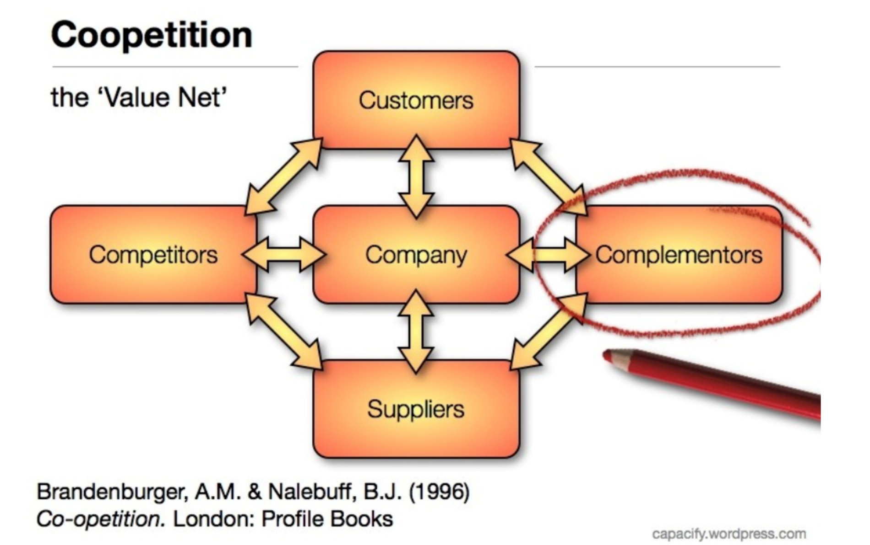

The Value Net
Notes:
Generalist strategy vs specialist strategy

Slide 38
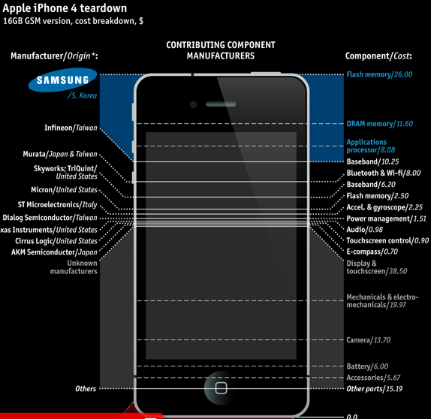
What about this? 25% of iphone 4 is samsung’s. is this open innovation?
War and piece
Notes:
five forces are high and strong, industries are not attractive.

Slide 39
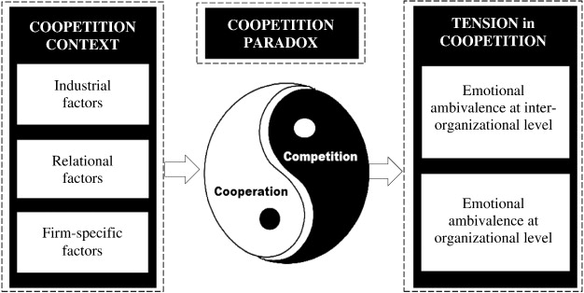
Coopetition paradox and tension in coopetition.
Raza-Ullah, T., Bengtsson, M., & Kock, S. (2014). The coopetition paradox and tension in coopetition at multiple levels. Industrial Marketing Management, 43(2), 189-198.
Notes:
How easy it is to enter the industry influences the degree of competition.
The greater the threat of entry, the worse it is for incumbents in an industry

Slide 40
Thank you!
Please post your questions on Piazza

